Slide 1

Exercise 1
Fontana Emanuele

Slide 2
Python library requirements
matplotlib: a comprehensive library for creating static, animated, and interactive visualizations in Python.
networkx: a Python package for the creation, manipulation, and study of the structure, dynamics, and functions of complex networks.

Slide 3
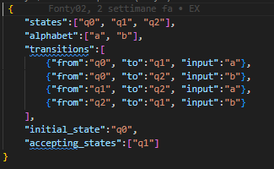
DFA’s representation
The DFA is encoded in JSON and is defined as follows:
states: the set of states of the DFA
alphabet: the set of acceptable input symbols
transitions: the set of transitions. A transition is described as follows:
- from: represents the current state
- to: represents the next state
- input: represents the input that triggers the transition
initial_state: represents the starting state
accepting_states: represents the set of acceptance

Slide 4
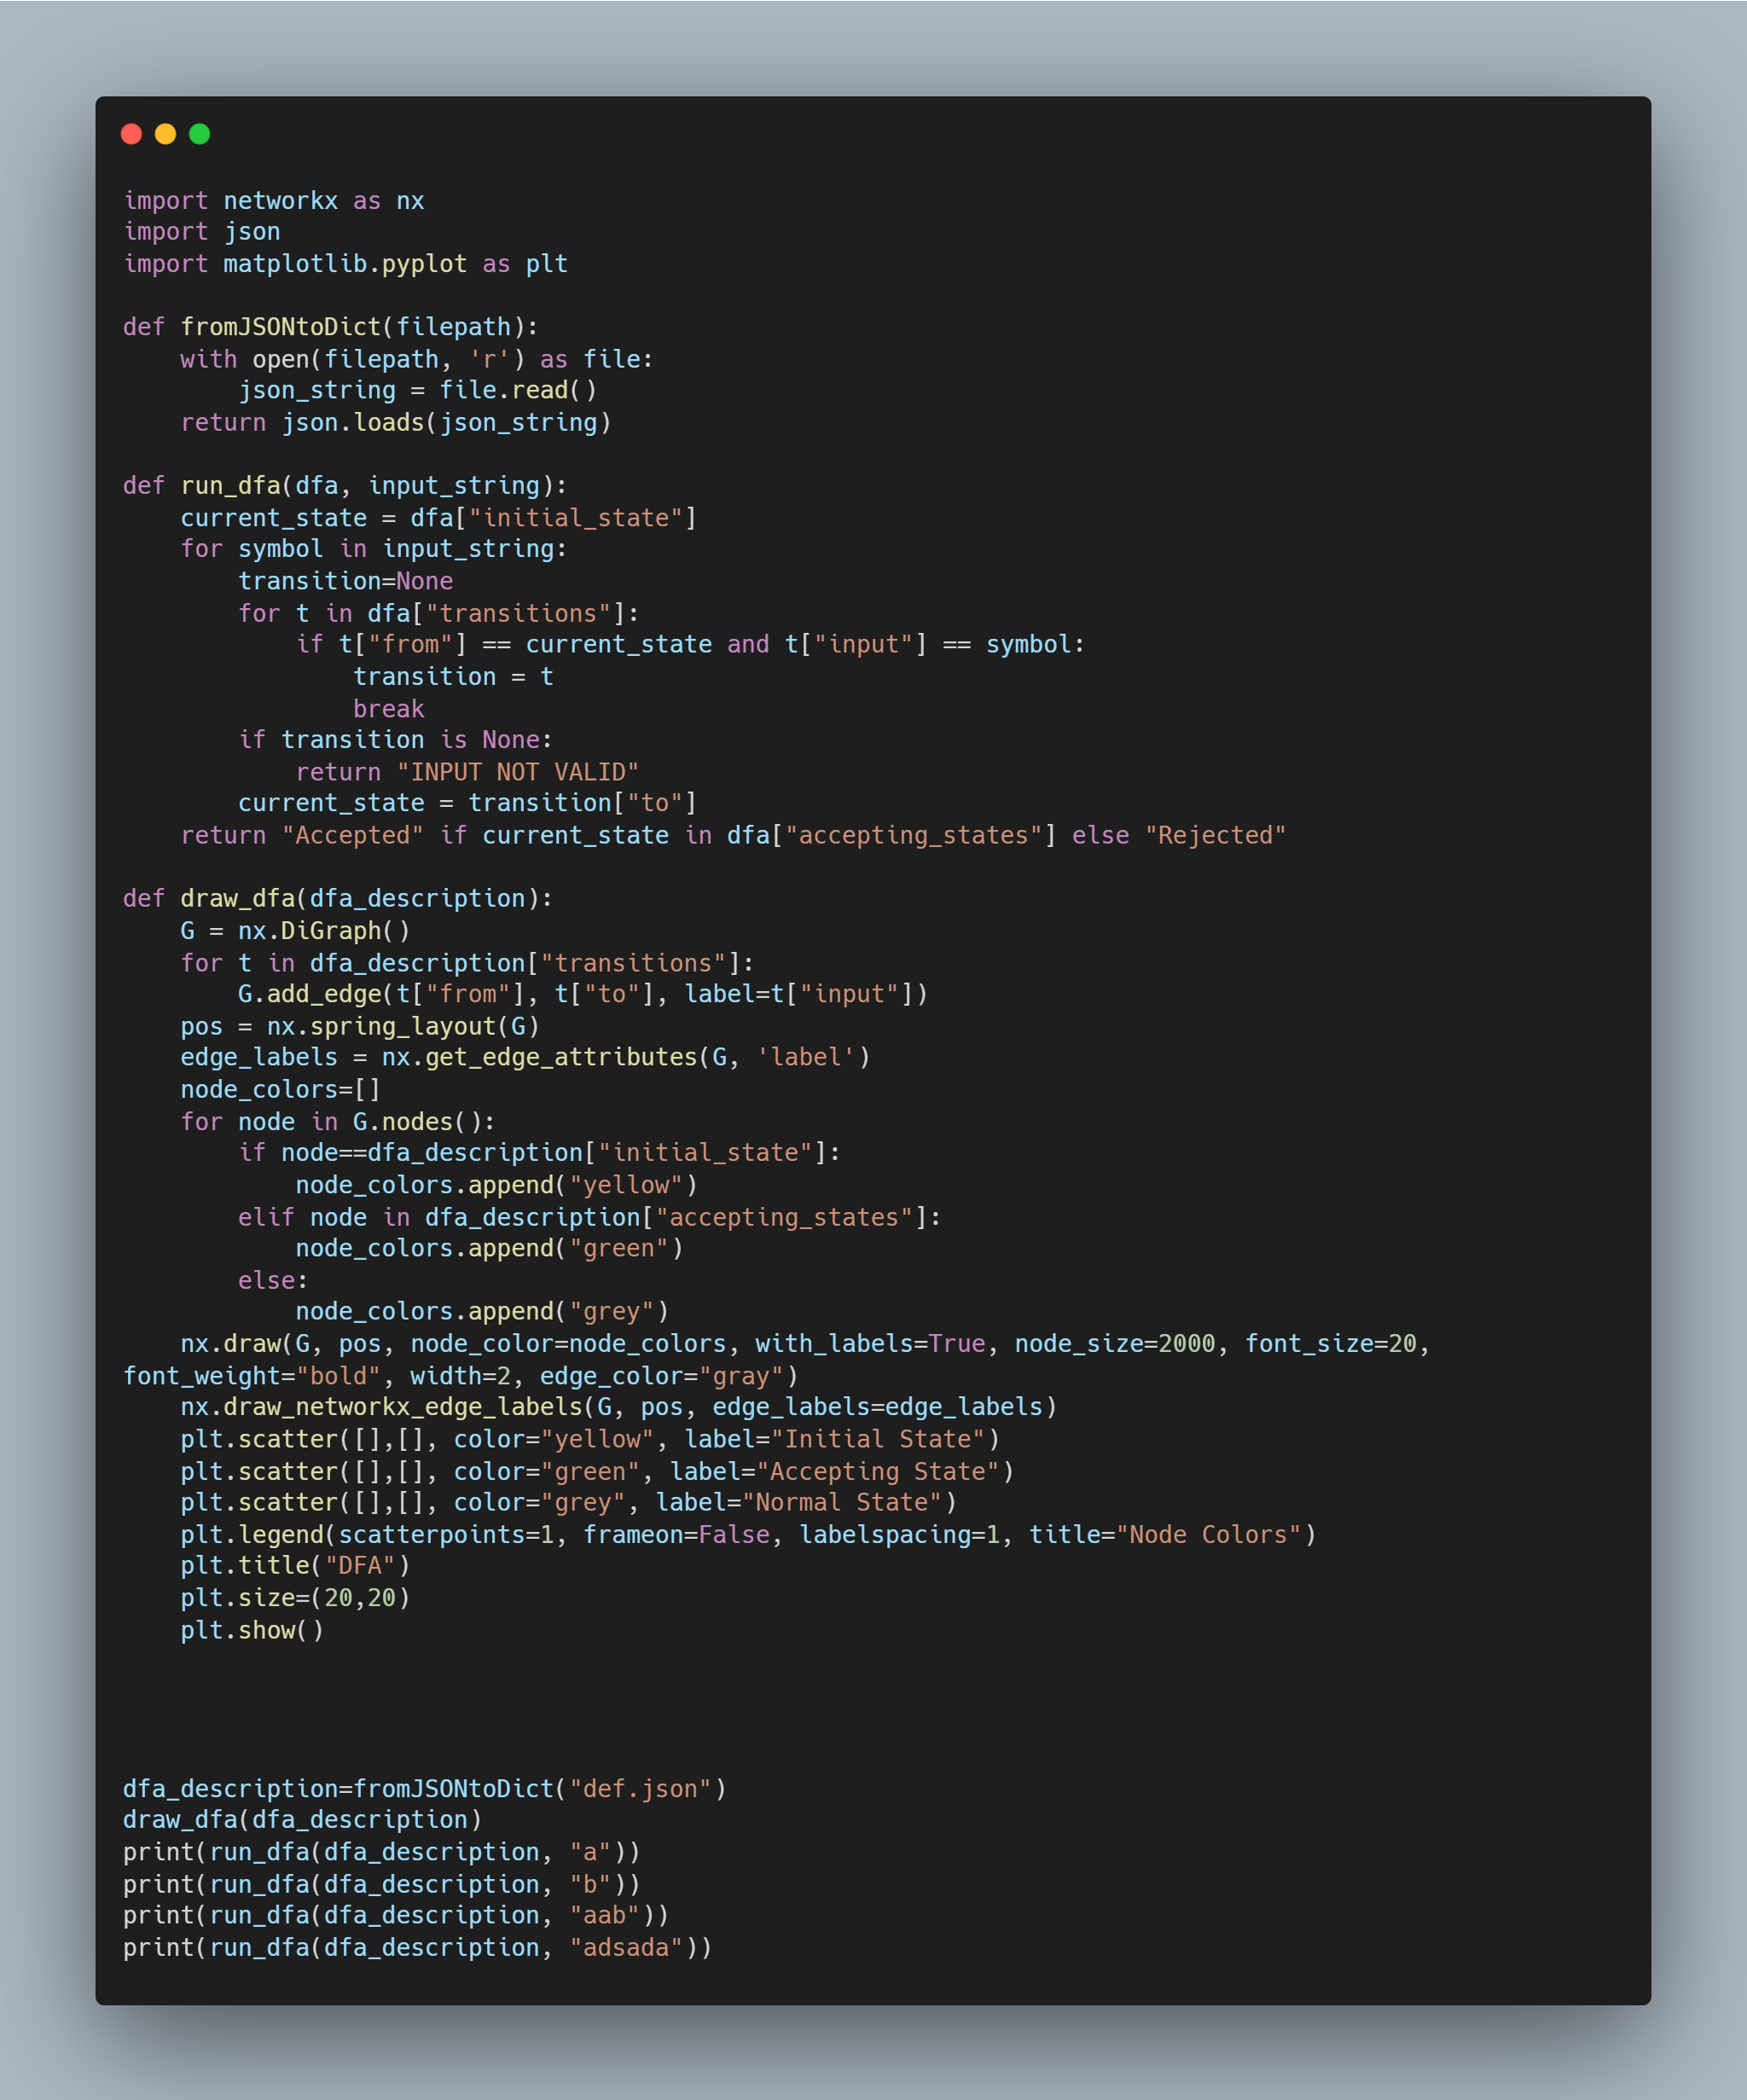
Python code
The code is composed as follows:
the function fromJSONtoDict reads the JSON file and converts it into a dictionary
the draw_dfa function draws the DFA passed as input parameter (which is the dictionary obtained from the previous function) corresponding to the description. In particular, the initial state is coloured yellow, the final states green and all others grey.
the run_dfa function simulates the behaviour of a DFA. It requires as input the DFA to be simulated, as a dictionary, and a string representing the input. The function will print out ACCEPTED if the input is accepted, REJECTED if it is rejected, and INPUT NOT VALID for invalid input (undefined transitions/symbols in input outside the alphabet)

Slide 5
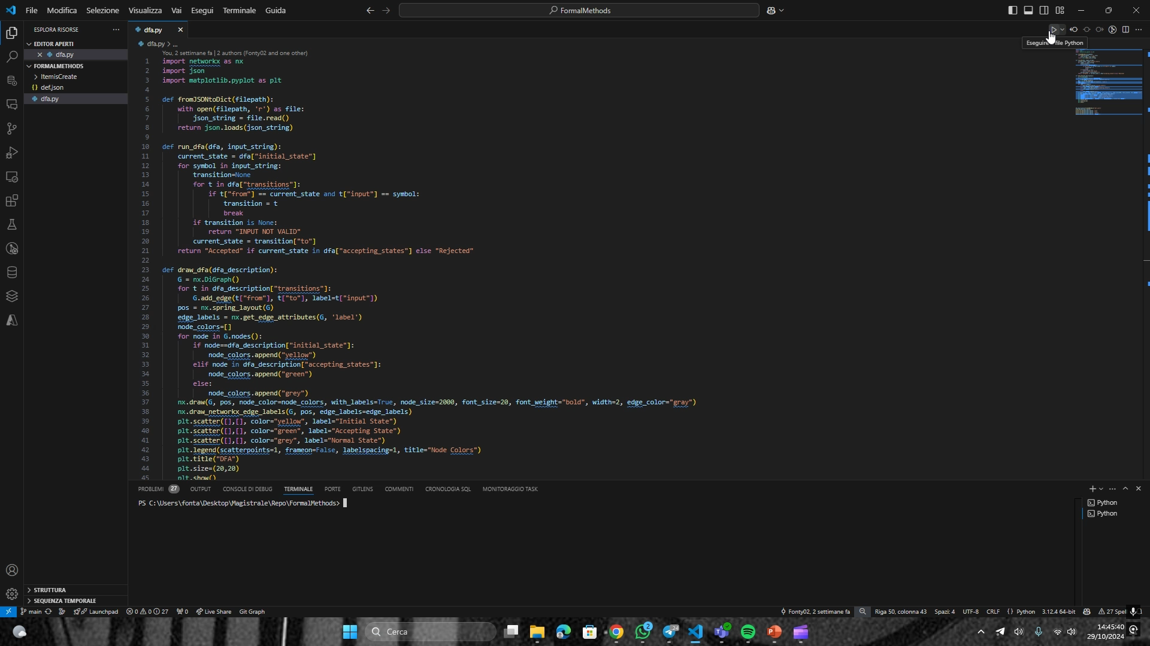
EXAMPLE OF EXECUTION

